Slide 1
FIRE SAFETY
at
MEDICAL CENTER HOSPITAL
04/2023

Slide 2
ACTIVATION
If you see smoke or fire: dial 2000 and state “fire” and the location.
You may also activate the fire alarm system by pulling a pull station located at designated exits.
If you smell something burning, but do not see smoke:
  Call Customer Service at ext. 2000 and report the situation.
Plant Operations will respond to investigate, and will activate the building fire alarm system, if necessary.
PBX will announce “Facility Alert + Fire Alarm Activation + Location” along with the message “activate R.A.C.E. procedure.”
Everbridge alert will be sent to the overhead announcement, screen takeover, and predesignated personnel.

Slide 3
WHO RESPONDS
Engineering
Police/Security
Any other available staff may also respond

Slide 4
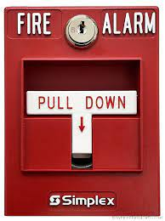
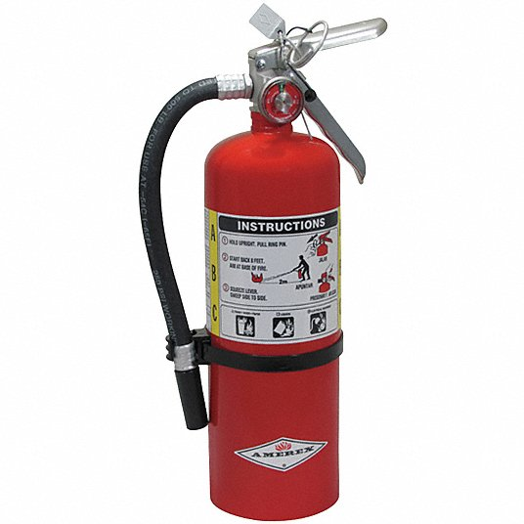
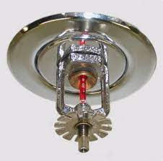
RESPONSE
Smoke or fire sighted: R A C E
R – Rescue/Remove People
Remove anyone who is in immediate danger.
A – Alarm Activation
Activate the fire pull station/call 2000.
C – Confine/Contain the Area
Close doors. Remove items from the corridor or move to one side in the event of an evacuation.
E – Extinguish
If safe, extinguish the fire using the fire extinguisher.
Use the P.A.S.S. technique to operate the extinguisher:
P – Pull the pin.
A – Aim at the base of the fire.
S – Squeeze the trigger.
S – Sweep from side to side.
Remain alert for further instruction or “All Clear”.

Slide 5
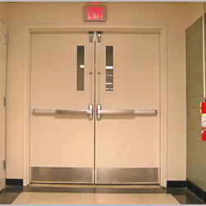
R.A.C.E
Rescue
Alarm
Confine
Extinguish
P.A.S.S
Pull the pin
Aim at the base of fire
Squeeze handle
Sweep side to side
DO NOT BLOCK
Pull stations
Fire Extinguishers
Smoke doors
CALL EXTENTION 2000 for ALL EMERGENCIES

Slide 6
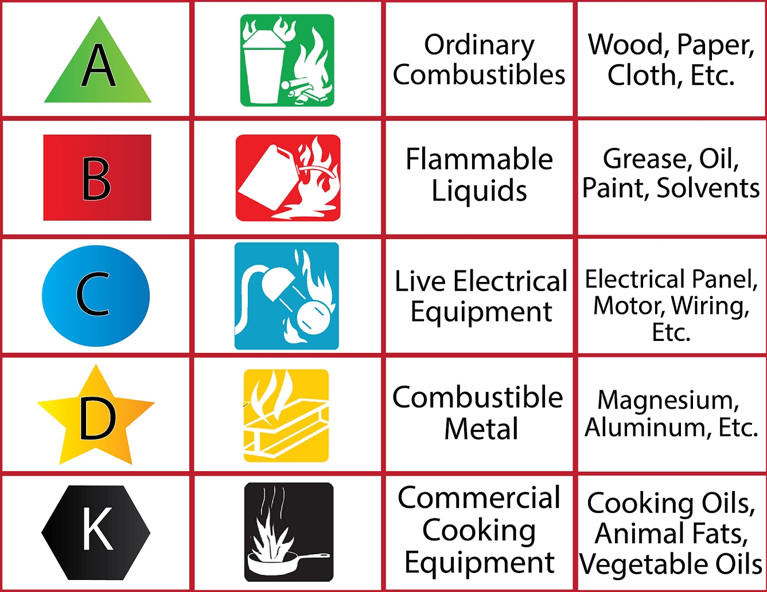
Classes of Fire:
Class A- Ordinary combustibles such as wood, paper, and trash
Class B- Flammable liquids such as gasoline, oil, and alcohol
Class C- Electrical equipment such as wiring and appliances
Types of Extinguishers:
ABC- Dry Chemical
BC- Carbon Dioxide
MAKE SURE THAT YOU USE THE APPROPRIATE EXTINGUISHER IN THE MRI AREA!!!

Slide 7
ADDITIONAL INFORMATION
General instructions for all employees including volunteers, LIPs, and students:
Keep telephone lines clear during the disaster for fire control.
Do not use elevators.
Make sure all fire, corridor, and room doors are closed.
Clear all corridors and exits of unnecessary traffic and obstructions.
If the strobe notification lights, the audible tones, or any of the doors close automatically in your department, you are to:
  Close all the patient doors
  Gather at the nurse’s station
  Monitor overhead alerts for more information
  Prepare to receive patients from the affected areas.
This is regardless of it the overhead announcement states a floor that is not adjacent, below, or above. The fire may spread, and the overhead can only announce one department at a time.
Reassure patients, families, and visitors that they are aware of the fire and that the organization has a response plan in effect.
Remain calm, fear and panic associated with smoke cause more deaths and serious injury than actual contact with flames.
In severe smoke, put a wet towel over your nose and mouth; keeping as close to the floor as possible.
DO NOT return to the affected area after evacuation.
There is a fire extinguisher simulator in the Safety Department, if you would like to go through the motions of extinguishing a fire, call ext. 1101 to set up some time.
For more information, please refer to policy MCH – 4050 Fire Alarm Activation

Slide 8
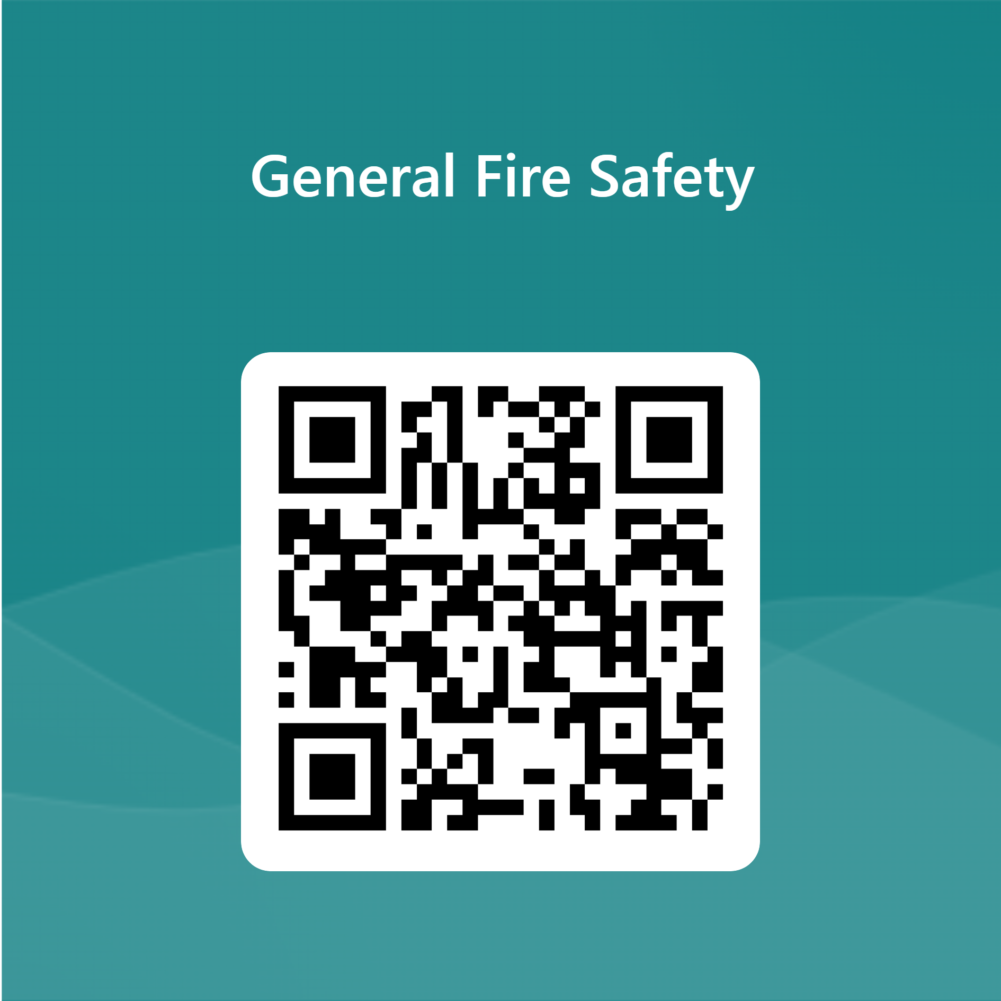
Continue to Test
Link:
https://forms.office.com/r/xFa2R4TzDJ

